Slide 1

ASSIGNMENT GUIDELINES
Make the changes in the PPT as you solve the parts
This file contains the template for all the parts of the project.
Check the instructions added in the note section of every slide for clarity.
Don’t move around any image or text box
If you require more/lesser elements, be careful when you copy/delete the existing ones.

Slide 2
ASSIGNMENT Name: Ayush Bansal
Problem Statement The sales pipeline conversion percentage at TechnoServe (a tech SaaS startup) has dropped from 35% at the end of last fiscal (FY 2017-18) to 25% at present.
Assignment Objective
Understand the problem, come up with a hypothesis for low conversions faced by TechnoServe, and analyse the dataset provided to arrive at possible solutions to increase it.
Notes:
Problem Statement

Slide 3
PART I : 1. Understanding the Problem Sales Pipeline Conversion at a SaaS Startup
Who?
The SaaS Startup
What?
The company’s sales pipeline conversion percentage has dropped from 35% to 25% at present.
When?
at the end of the last fiscal FY 2017-18
Where?
In the sales pipeline conversion
How?
Innovation, customer, sales related issue

Slide 4
PART I : 2. Understanding the Problem Sales Pipeline Conversion at a SaaS Startup
Situation
What is the strength of sales team
What is the length of project
How much conversion targeted
Problem
Is there technology to add new features in the product
Is company ready to hire talented tech employee or hire tech consultant
Is sales team skilled to answer customer query
Implication
It will reduce more sales conversion pipeline rate in future
It will impact company future profit.
It will impact company market share.
Need-Payoff
New technology and innovation will increase sales conversion pipeline rate
Investing in new technology will reduce the cost
New technology will make sales team more powerful to convince and convert customer
Notes:
Provide at least three questions under each branch.

Slide 5
PART II : Formulating Hypotheses Sales Pipeline Conversion at a SaaS Startup
Framework Used
BANT
Reason for using the selected framework
The BANT is a framework that helps you identify good leads from the customer pool.
The framework helps you measure the quality of sales prospects and analyses their likelihood of converting into successful customers.
How you have used the framework here
After taking the interview of existing customer and new customer. Came to the point that customer don’t want to buy the product because of no new additional feature and innovation in the product
Notes:
All the frameworks that are used should be mentioned.
A suitable reason is a must to provide here

Slide 6
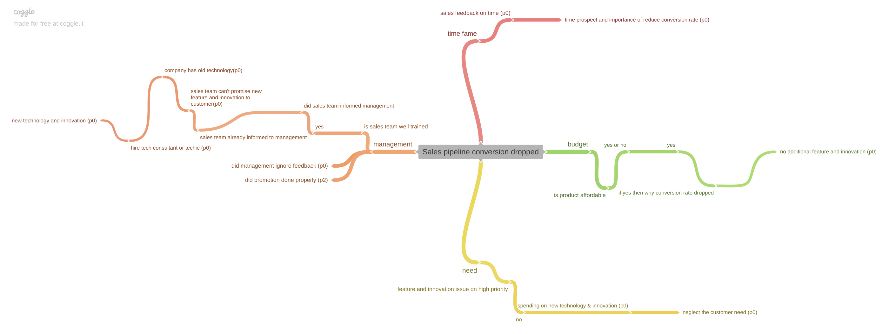
PART II : Formulating Hypotheses Sales Pipeline Conversion at a SaaS Startup
Provide the structure of the framework here
(You can attach the screenshot or multiple screenshots depending on the clarity of the image)
Notes:
Use the “download as” feature of Coggle if you are using the tool.
Provide one image with complete tree along with separate elements where the text is readable.
Copy the slide if you require more space

Slide 7
PART II : Formulating Hypotheses Sales Pipeline Conversion at a SaaS Startup
Branch 1 - budget
Is customer afford the products – yes / no, answer is yes
Hypotheses 1: if customer afford the product – why customer doesn’t want to buy the products
Hypotheses 2: why customer doesn’t want to buy the products – customer want new innovation and additional features in the product.
Branch 2 – Need
Hypotheses 1: new technology and innovation is very important for prospects
Hypotheses 2: why management did not take new features and innovation issue on high priority
Notes:
Each branch must follow this naming pattern: Problem – Branch 1 – Sub-branch 1 – Sub-branch 2 – …… – Hypotheses
There must be minimum 10 hypotheses in total and at least 1 in each branch.

Slide 8
PART II : Formulating Hypotheses Sales Pipeline Conversion at a SaaS Startup
Branch 3 – Management
Hypotheses 1: why sales team neglected the customer’s need
Hypotheses 2: sales team can’t promise to customer for additional features and innovation which competitor gives.
Hypotheses 3: why company is stuck with old technology – company is not hiring talented people or not hire technology consultant to suggest of new innovation and technology
Hypotheses 4: authority does’t want to invest to hire techno savvy people or technology consultant to suggest new innovation and technology.
Branch 4 – time frame
Hypotheses 1: is this prospects have the importance means to add new technology and innovation in yor product
Hypotheses 2: how long do they intend to take to implement the solution provided, and how quickly can management meet the requirement?
Notes:
Each branch must follow this naming pattern: Problem – Branch 1 – Sub-branch 1 – Sub-branch 2 – …… – Hypotheses
There must be minimum 10 hypotheses in total and at least 1 in each branch.

Slide 9
PART III A : Generating Insights Sales Pipeline Conversion at a SaaS Startup
Variable
Overall technology primary conversion average won rate shows 22.59%
medium conversion average won rate shows 22.59%
Insights if any
Technology primary – legacy modernization shows lower conversion won rate at 12.15%
Online leads shows lower conversion won rate at 6.46%
Last year no business show ERP implementation at higher counting 49810
Pune and Kolkata shows lower conversion won rate 18.88% and 21.27% respectively
Pattern of Insight
Overall conversion average won rate on city basis is 22%.
Notes:
Analyse the variables in the dataset, find the insights and mention the pattern of insights in the data. Make more copies of this slide if needed.

Slide 10
PART III A : Generating Insights Sales Pipeline Conversion at a SaaS Startup
Variable under consideration:
Technology primary- conversion rate in %
Technology primary- analytics shows higher conversion won rate at 26.33%
Technology primary- legacy modernization shows lower conversion won rate at 12.15%%
Notes:
For each variable that produced an interesting insight, explain you analysis bit here – the results you got from excel and the necessary visualisations. Note: it is compulsory for you to mention the results of the analysis on these variables - 'Technology Primary', 'B2B Sales Medium', 'Client Revenue Sizing', 'Opportunity Sizing' and 'Business from Client last year’.

Slide 11
PART III A : Generating Insights Sales Pipeline Conversion at a SaaS Startup
Variable under consideration:
Technology primary of conversion rate by opportunity size (USD)
Legacy modernization shows higher conversion won rate at 29%
Analytics shows lower conversion won rate at 19%
Notes:
For each variable that produced an interesting insight, explain you analysis bit here – the results you got from excel and the necessary visualisations. Note: it is compulsory for you to mention the results of the analysis on these variables - 'Technology Primary', 'B2B Sales Medium', 'Client Revenue Sizing', 'Opportunity Sizing' and 'Business from Client last year’.

Slide 12
PART III A : Generating Insights Sales Pipeline Conversion at a SaaS Startup
Variable under consideration:
B2B sales medium- conversion rate %
Enterprise seller shows higher conversion won rate at 27.57%
Online leads shows lower conversion won rate at 6.46%
Notes:
For each variable that produced an interesting insight, explain you analysis bit here – the results you got from excel and the necessary visualisations. Note: it is compulsory for you to mention the results of the analysis on these variables - 'Technology Primary', 'B2B Sales Medium', 'Client Revenue Sizing', 'Opportunity Sizing' and 'Business from Client last year’.

Slide 13
PART III A : Generating Insights Sales Pipeline Conversion at a SaaS Startup
Variable under consideration:
No business from client last year- counting basis
Last year no business shows legacy modernization and analytics at lower counting 609 and 281 respectively
Overall technology primary- last year no business shows at counting 78025
Notes:
For each variable that produced an interesting insight, explain you analysis bit here – the results you got from excel and the necessary visualisations. Note: it is compulsory for you to mention the results of the analysis on these variables - 'Technology Primary', 'B2B Sales Medium', 'Client Revenue Sizing', 'Opportunity Sizing' and 'Business from Client last year’.

Slide 14
PART III A : Generating Insights Sales Pipeline Conversion at a SaaS Startup
Variable under consideration:
Conversion won rate in % on city base
Mumbai and Delhi shows higher conversion won rate 25.37% and 22.74 respectively
Pune and Kolkata shows lower conversion won rate 18.88% and 21.27% respectively
Notes:
For each variable that produced an interesting insight, explain you analysis bit here – the results you got from excel and the necessary visualisations. Note: it is compulsory for you to mention the results of the analysis on these variables - 'Technology Primary', 'B2B Sales Medium', 'Client Revenue Sizing', 'Opportunity Sizing' and 'Business from Client last year’. Make more copies of this slide if needed.

Slide 15
PART III A : Generating Insights Sales Pipeline Conversion at a SaaS Startup
Recommendations
Technology and innovation should be on high priority
Invest in Hiring teach savvy employee or technology consultant
This investment will help to increase won conversion rate in future
Corresponding Insights
Overall technology primary conversion average loss rate is 77.41%
Last year no business show ERP implementation at higher counting 49810
Pune and Kolkata shows lower conversion won rate 18.88% and 21.27% respectively
Interview with new and existing customer shows they are not buying because no new technology and innovation
No investment in technology and innovation result in declining conversion rate
Notes:
For each recommendation explain the insights that form the reasoning for giving that recommendation. Make more copies of this slide if necessary.

Slide 16
PART III B : PRESENTINGS FINDINGS Sales Pipeline conversion at a SaaS Startup Higher Sales Pipeline Converison Won Rate New Technology and Innovation
Customer need new features and innovation Management old buying decisions on clients
Customer can buy Customer buy features and innovations No Innovations low Sales team
afford product at competitors low conversion rate neglect customer need

